Slide 1
Part 3: Visualization with Matplotlib
VISUALIZATION

Slide 2
Visualization with Matplotlib
Introduction To Matplotlib
Introduction To Seaborn

Slide 3
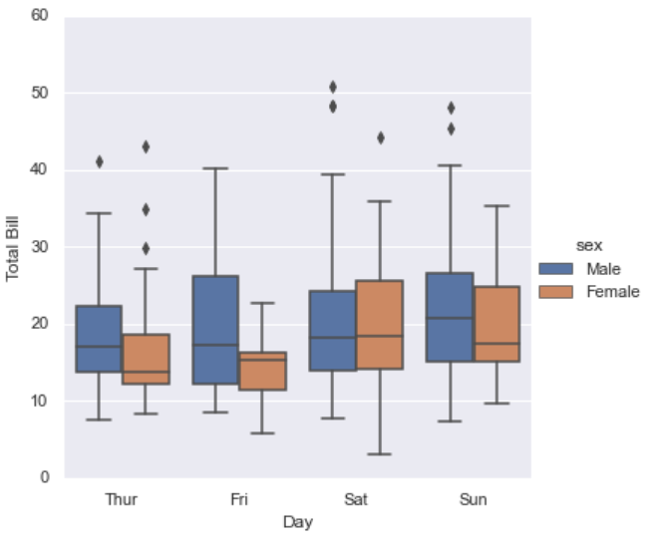
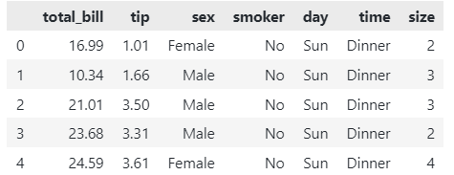
Why data visualization is needed?
tips = sns.load_dataset('tips')
tips.head()

Slide 4
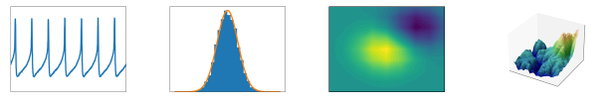
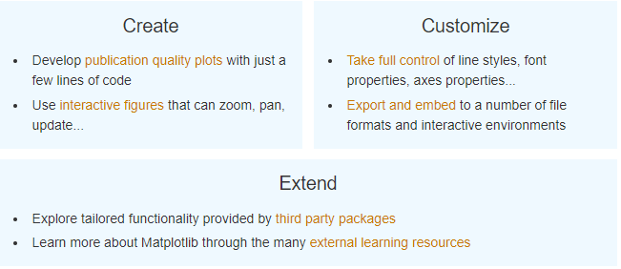
1. Introduction To Matplotlib
Matplotlib is a comprehensive library for creating static, animated, and interactive visualizations in Python.
Matplotlib makes easy things easy and hard things possible.

Slide 5
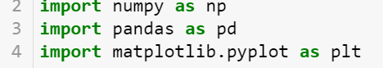
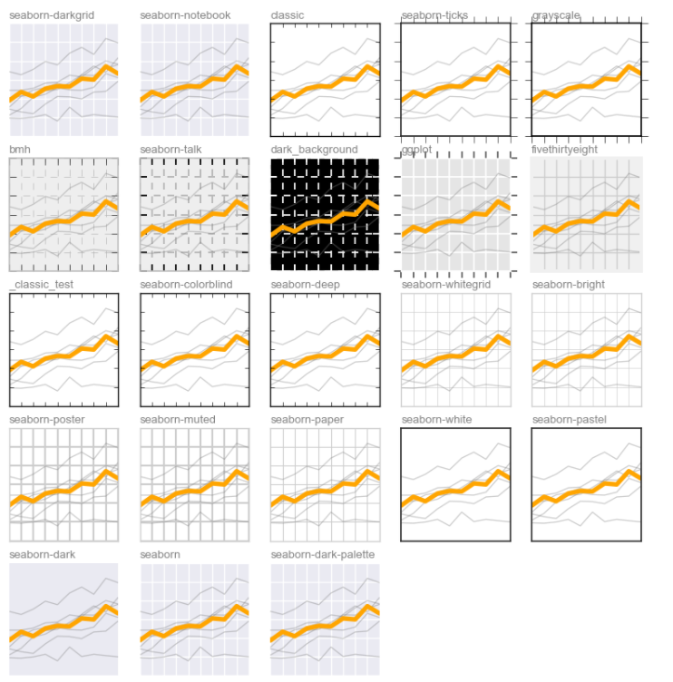


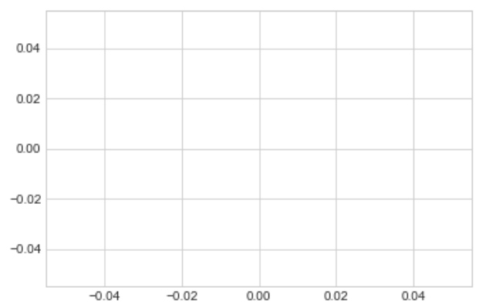
1. Introduction To Matplotlib
General Matplotlib Tips
['Solarize_Light2', '_classic_test_patch', 'bmh', 'classic', 'dark_background', 'fast', 'fivethirtyeight', 'ggplot', 'grayscale', 'seaborn', 'seaborn-bright', 'seaborn-colorblind', 'seaborn-dark', 'seaborn-dark-palette', 'seaborn-darkgrid', 'seaborn-deep', 'seaborn-muted', 'seaborn-notebook', 'seaborn-paper', 'seaborn-pastel', 'seaborn-poster', 'seaborn-talk', 'seaborn-ticks', 'seaborn-white', 'seaborn-whitegrid', 'tableau-colorblind10']
Importing Matplotlib
Setting Styles
We will use the plt.style.use directive to choose appropriate aesthetic styles for our figures

Slide 6
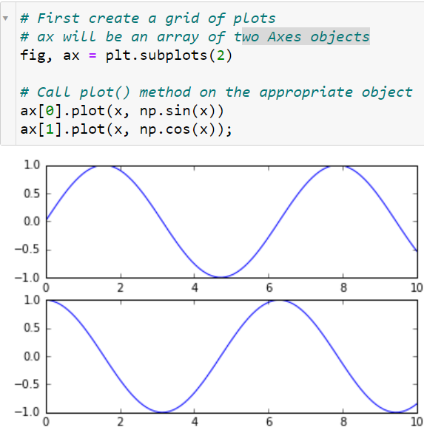
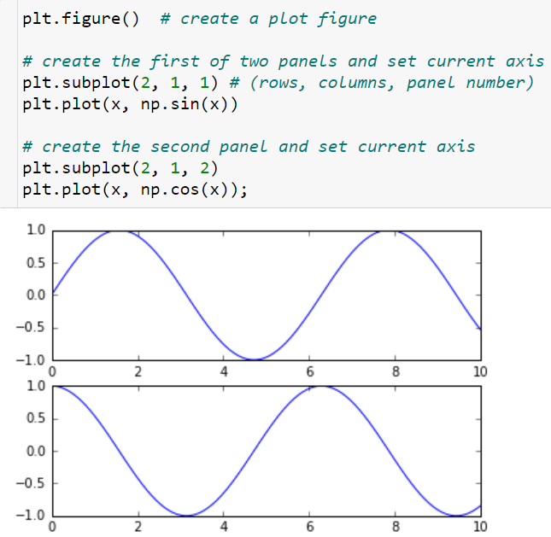
Introduction To Matplotlib
Object-oriented interface
Two Interfaces for the Price of One
MATLAB-style Interface
OO Style: Working directly with Figure and Axes objects.

Slide 7
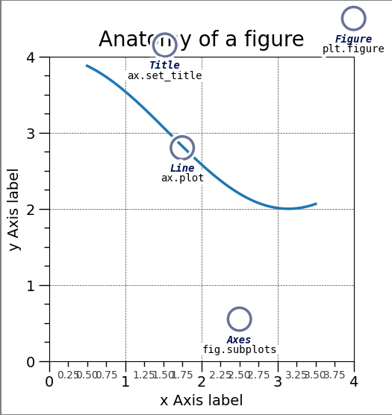
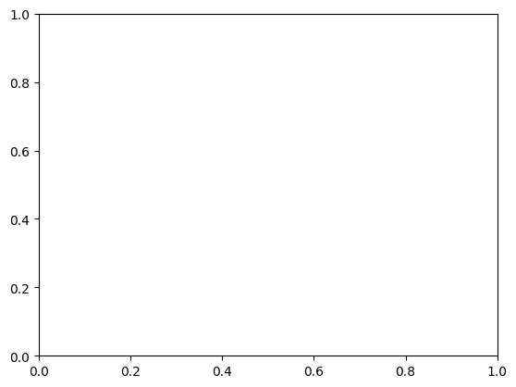
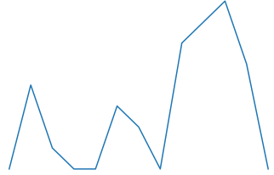
Parts of a Figure
figure
The tilte of chart

Slide 8
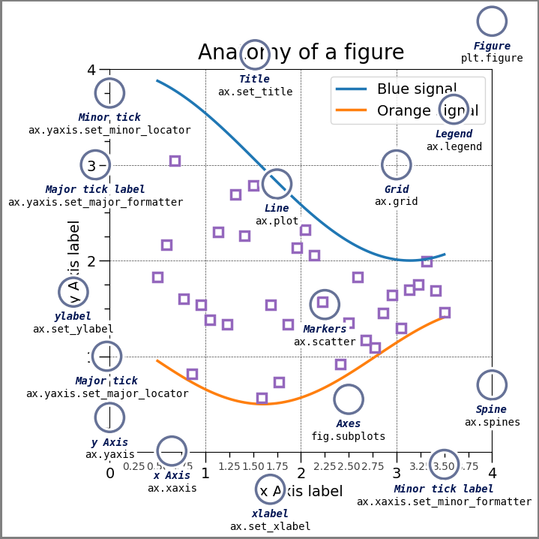
Parts of a Figure

Slide 9
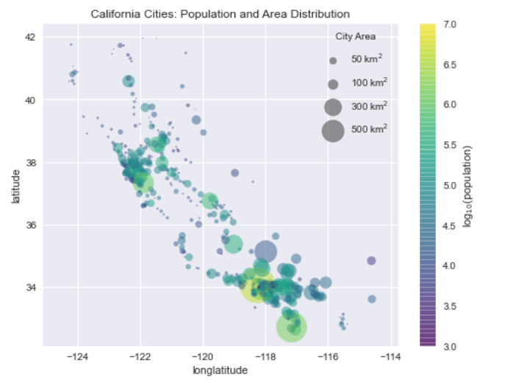
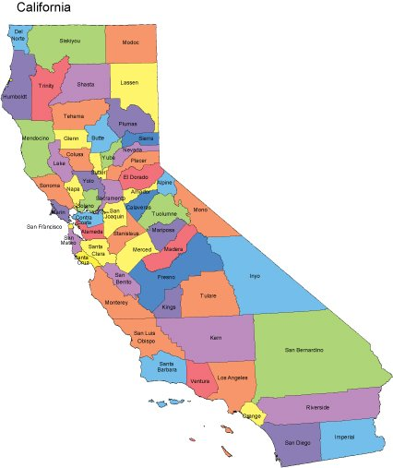
Practice: Data Visualization - California Cities

Slide 10
Multiple Subplots
Introduction to Using thefollowing methods in OOP style:
plt.subplots,
plt.subplot_mosaic, and
plt.add_gridspec

Slide 11
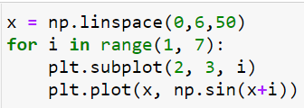
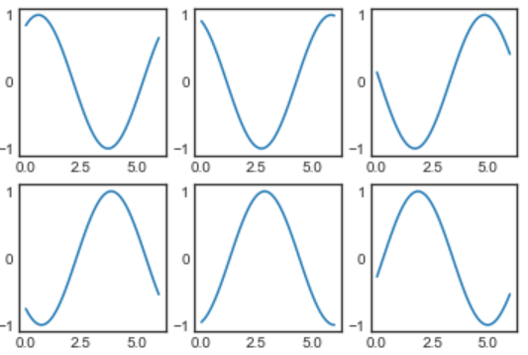
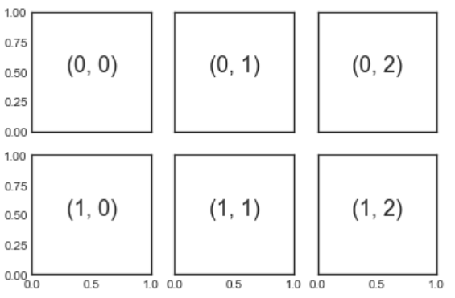
Multiple Subplots
plt.subplots: The Whole Grid in One Go
plt.subplot: Simple Grids of Subplots
fig, axes = plt.subplots(nrows=2,ncols=3,
figsize = (6,4),
sharex=True, sharey=True)
for i in range(2):
for j in range(3):
axes[i,j].text(0.4,0.4, str((i,j)))

Slide 12
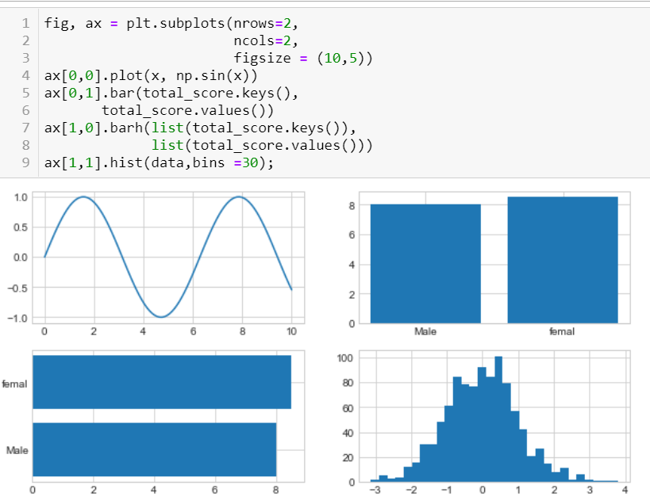
Multiple Subplots

Slide 13
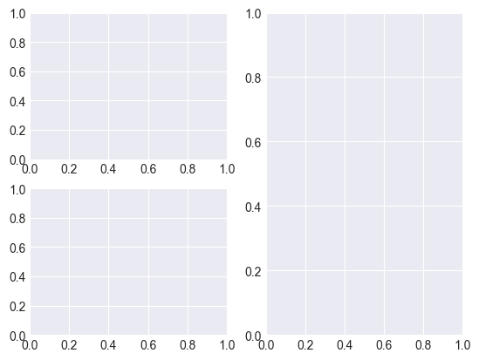
Multiple Subplots
plt.subplot_mosaic:
Create more complex layouts using labels or names to specify the position of Axes.
fig, axs = plt.subplot_mosaic([
['left', 'right'],
['bottom', 'right']
])

Slide 14
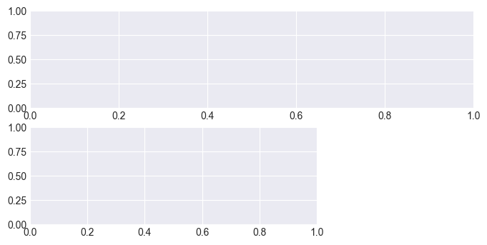
Multiple Subplots
Fig.add_gridspec:
Create detailed and flexible layout
fig = plt.figure(figsize=(8, 6))
gs = fig.add_gridspec(3, 3)
ax1 = fig.add_subplot(gs[0, :])
ax2 = fig.add_subplot(gs[1, :-1])

Slide 15

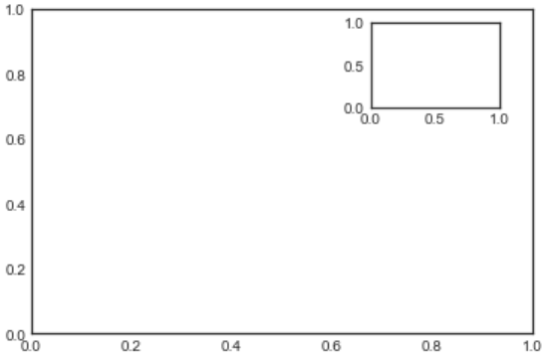
Multiple Subplots
plt.axes: Subplots by Hand
The most basic method of creating an axes is to use the plt.axes function.
[left, bottom, width, height]

Slide 16
Multiple Subplots
Comparison and Choice
plt.subplots: Simple, easy to use for basic layouts.
plt.subplot_mosaic: Flexible with labels, suitable for complex layouts.
plt.add_gridspec: Detailed control and high customization.

Slide 17
Practice
Create a Plot Using the Titanic Dataset
Use the Titanic dataset to create a Figure with 3 Axes:
One Axes displays a bar plot of survival rates by class, occupying the top row.
One Axes displays a box plot of ages by class, occupying two-thirds of the second row.
One small Axes displays a histogram of ages, located at the bottom right corner.

Slide 18
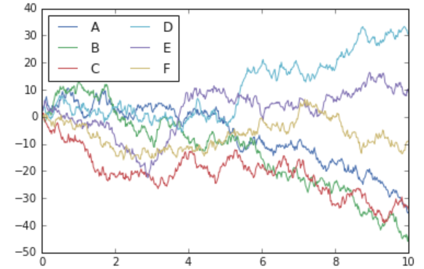
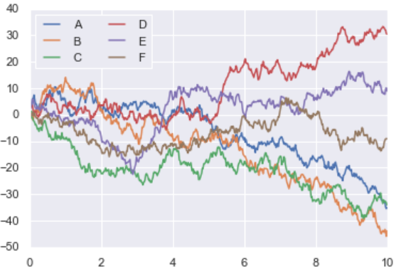
2. Introduction to Seaborn
Seaborn Versus Matplotlib
The Python visualization library Seaborn is based on matplotlib and provides a high-level interface for drawing attractive statistical graphics. Make use of the following aliases to import the libraries:
# import three necessary libraries
import seaborn as sns
import pandas as pd
import matplotlib.pyplot as plt
# to ignore the warnings
from warnings import filterwarnings
The basic steps to creating plots with Seaborn are:
Prepare some data
Control figure aesthetics
Plot with Seaborn
Further customize your plot

Slide 19
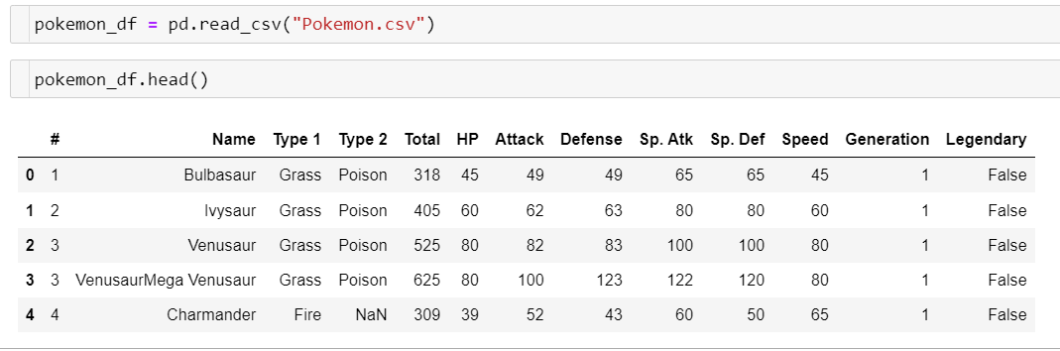

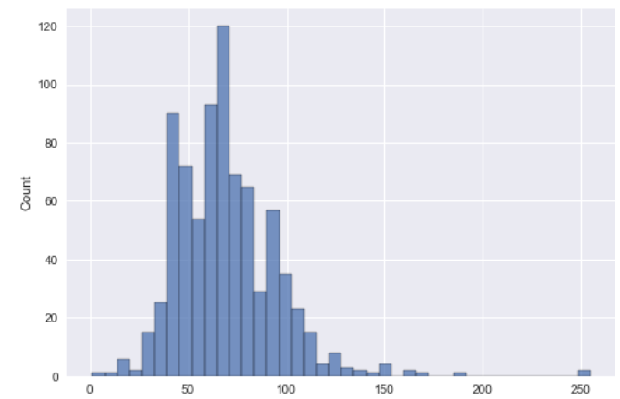
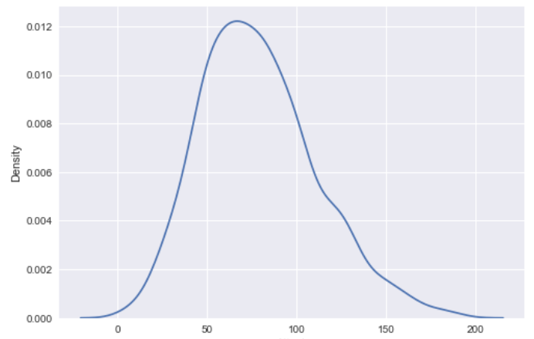
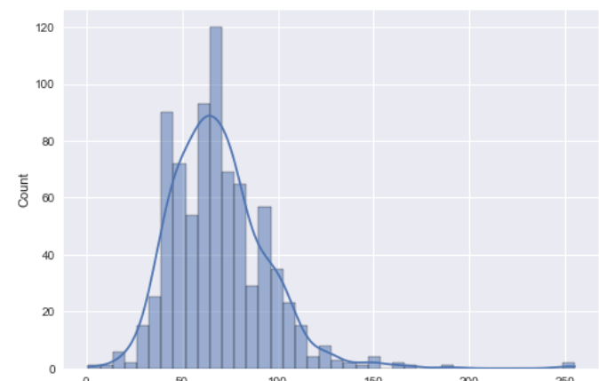
Distribution: Hist, KDE
sns.kdeplot(pokemon_df.Attack);

Slide 20
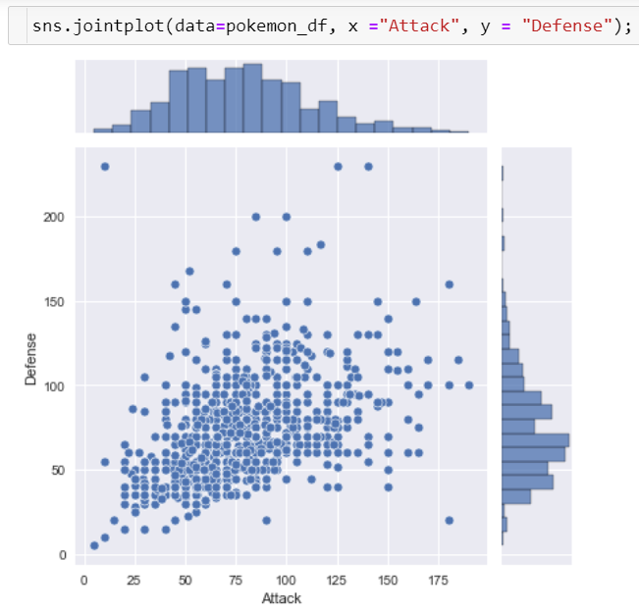
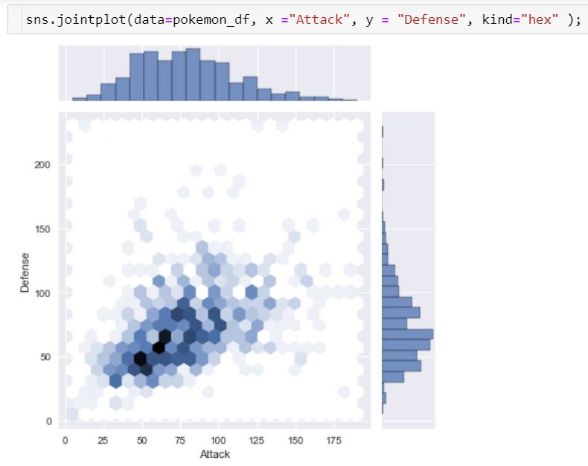
Join Plot

Slide 21

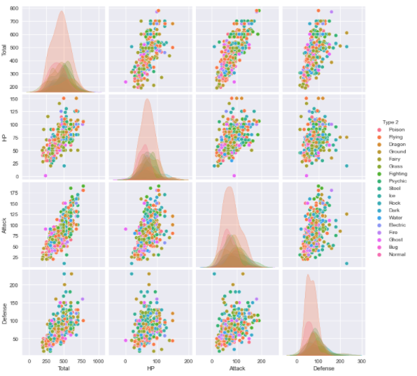
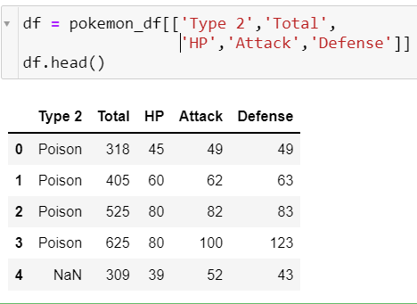
Pair plots
When you generalize joint plots to datasets of larger dimensions, you end up with pair plots. This is very useful for exploring correlations between multidimensional data, when you'd like to plot all pairs of values against each other.

Slide 22

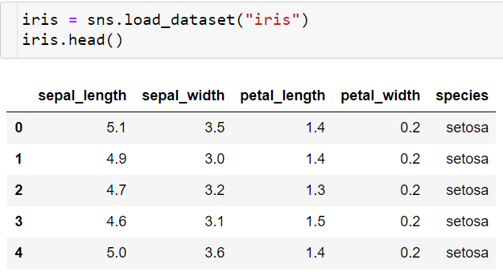


Practice
Iris dataset

Slide 23

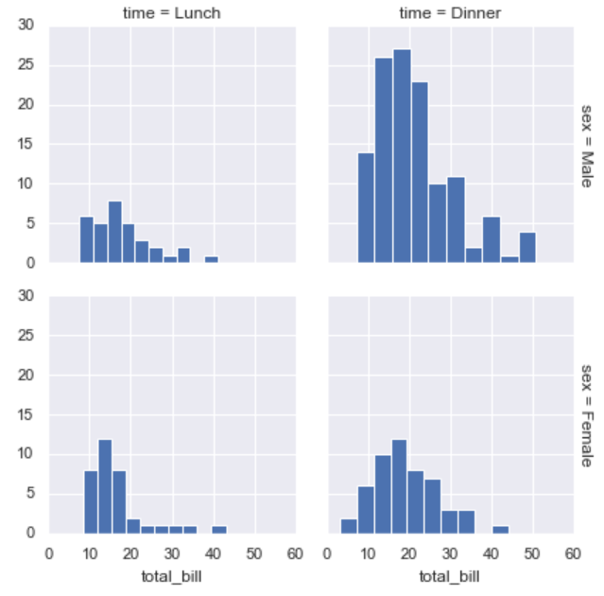
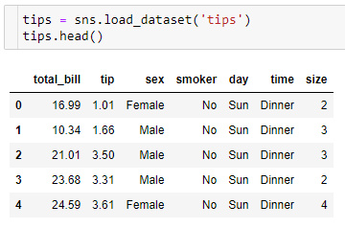
Facet Plots
Faceted histograms
Sometimes the best way to view data is via histograms of subsets. Seaborn's FacetGrid makes this extremely simple. We'll take a look at some data that shows the amount that restaurant staff receive in tips based on various indicator data:

Slide 24


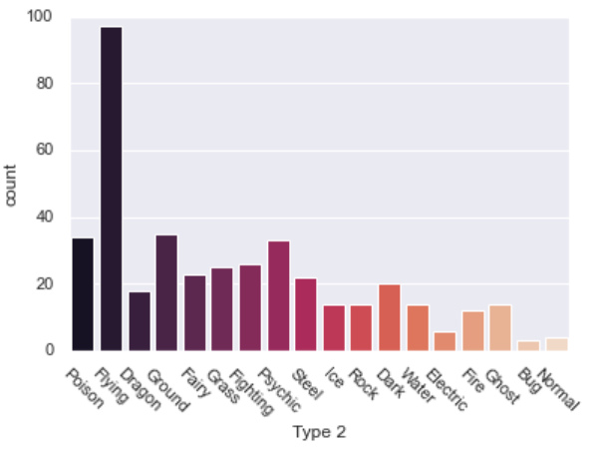
Factor and Bar plots
Factor plots
Bar plots

Slide 25
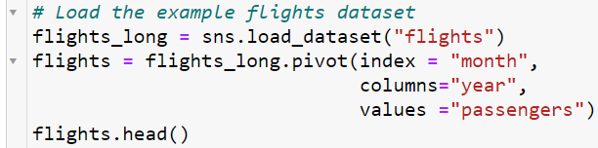
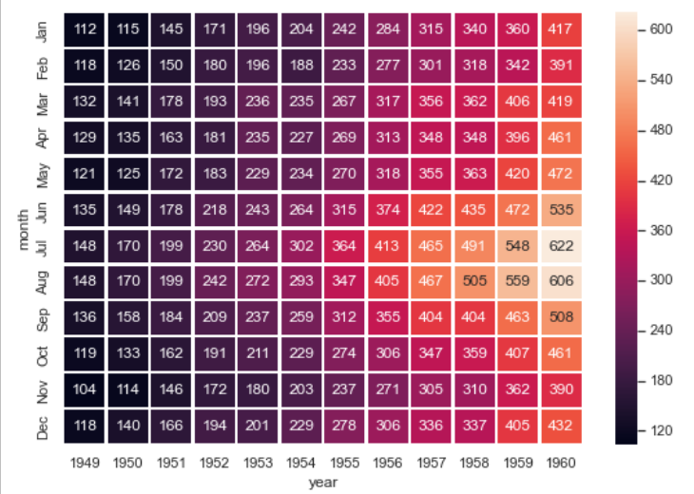
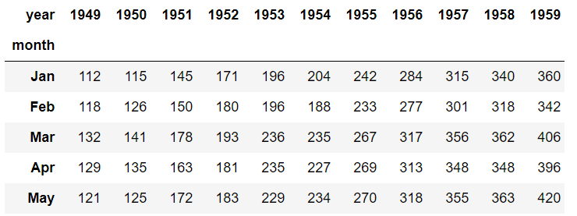

Heatmap
Heatmap

Slide 26
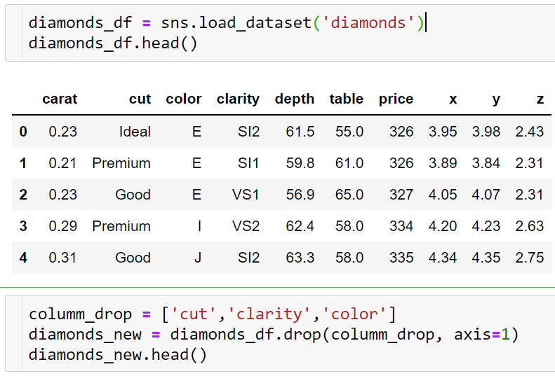
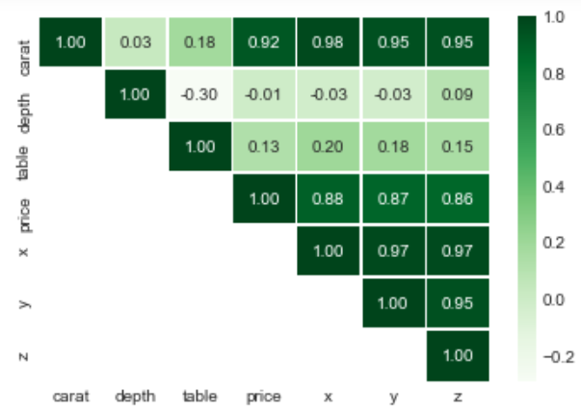

Practice: Visualization Correlation

